Slide 1
MEDICAL-LEGAL PARTNERSHIP WORKFLOWS How can I get the MLP legal team’s help addressing my patient’s housing issues?
Notes:
*This training is designed to be delivered by a lawyer or paralegal to healthcare providers. It’s meant to help healthcare providers’ understand both what ways the MLP legal team can support patients’ legal needs and the logistics for making a referral at that specific MLP. This training was created for Kaiser Permanente MLPs, so the specific information about what issues the MLP team handles and the referral procedures in this PowerPoint slide deck are specific to those MLPs. Other MLPs can use this training as a sample and edit it with information specific and relevant to their program. The training should take 20-25 minutes to deliver (15-20 minutes for presentation and 5-10 minutes for questions).
Notes for Presenter:
This training is to introduce or remind healthcare team members about ways they can connect patients with legal services and about MLP workflows. Weave in examples from recent Curbside Consults and referrals to help illustrate these processes.
Review the information in the slide deck and make sure that it is relevant to your healthcare organization, legal aid organization and MLP practice. Make updates as needed. Pay particular attention to the text highlighted in yellow as it is likely to be different across different MLP sites.

Slide 2
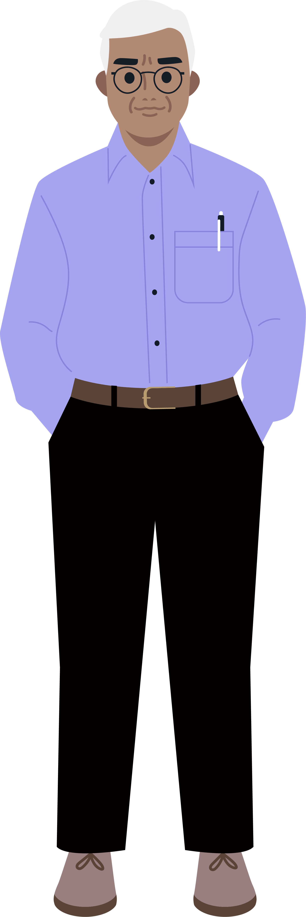
METHOD #1: LEGAL ASSISTANCE FOR PATIENTS Refer A Patient to the Legal Team
Housing Issues You Can Refer
Eviction / Eviction-Risk: Patient received paperwork asking them to appear in court or paperwork saying they need to move.
Illegal Lockouts: A patient’s landlord restricts or threatens to restrict the patient’s access to their housing (e.g., changing locks, shutting off utilities) without going through the proper eviction procedures (i.e., getting a court order).
Housing Assistance: Patient is at-risk of losing their Section 8, public housing, or other housing subsidy.
Habitability & Repairs: Patient has mold or rodents in their unit and/or broken locks, windows, or utilities.
Discrimination: Patient feels they are being treated differently than other tenants because of their membership in a protected class.
Retaliation: Patient feels they are being retaliated against because they made a complaint about their rental unit.
Criminal Record: Patient is struggling to find housing because of a criminal record.
Once a patient is referred, the legal team will do a legal intake to evaluate their situation for potential services.
Notes:
Note for presenter:
Review and edit the list of referral issues to make sure it is accurate for your MLP program.

Slide 3
THRIVE LOCAL WORKFLOWS How to Make a Referral to the MLP Legal Team
Go to Health Connect
Identify & select member
Open an encounter
Enter the dot phrase .MLP
Use smart phrases to assess housing legal-needs
Go to Thrive Local
Create a referral to Neighborhood Legal Services of Los Angeles
Complete “Consent by Attestation Form”
Type region’s MLP in the search box: NLSLA Kaiser Permanente SoCal: Medical Legal Community Partnership
Choose primary reason for the referral
Copy and paste relevant smart phrases from Health Connect
Complete network assessments and submit.
Review the Referral Process
Video Demonstration
Step-by-Step Written Instructions
Notes:
Note for presenter:
Review and edit the referral process steps to make sure it is accurate to your MLP program. (On this slide, Health Connect is the electronic health record used by Kaiser Permanente and Thrive Local is a customized version of Unite Us, a third-party referral platform used by Kaiser Permanente to connect with community partners.)

Slide 4
METHOD #2: CURBSIDE CONSULTS Informally Ask the MLP Legal Team Questions
Reasons to Do a Curbside Consult
You aren’t sure if a particular patient is appropriate to refer to the MLP legal team. You might have a question about their eligibility for services or whether their issue is something the legal team can help with.
You have a general question about a housing or related legal topic. Maybe you’ve seen several patients recently who have received a particular type of housing notice and you want more information about what it is and what it means for patients who have received one.
Where to Do a Curbside Consult
During MLP Office Hours
At any care coordination or clinical meeting the MLP legal team attends
One-on-one as needed. [Share how to request one.]
Notes:
Notes for presenter:
Give examples of good Curbside Consults. Discuss and differentiate when healthcare staff should to do a Curbside Consult instead of a referral.
Share the procedure for requesting a Curbside Consult.

Slide 5
ENSURE PATIENT CONFIDENTIALITY Do’s and Don’t of Curbside Consults
+ DO’s
Do make it short and to the point. Give context without sharing too many details.
Do ensure you know the patient’s goals and communicate them to the legal team.
Do be clear about your goals.
x DON’Ts
Don’t share personally identifiable information (PII) or personal health information (PHI) with the legal team.
Don’t seek advice about subpoenas or other situations where anticipated legal action involves the healthcare organization or a healthcare staff person.
Don’t seek advice about personal legal issues.

Slide 6
RESPECTING PRIVACY When You Need to Obtain Patient Consent
Dig Deeper: Review Consent Job Aid
Definitions
Scenario | Type of Consent | Okay to Share PII? | Okay to Share PHI?
Curbside consults (almost all) | NONE | NO | NO
Curbside consults (where PHI is relevant) | WRITTEN | NO | YES only as needed for curbside consult
Patient referral to the MLP legal team | VERBAL | YES | NO
Discussion of patient’s open legal case (no discussion of PHI) | VERBAL | YES | NO
Discussion of patient’s open legal case (discussion of PHI) | WRITTEN | YES | YES to extent allowed by HIPAA release
PERSONALLY IDENTIFIABLE INFORMATION (PII)
Data that confirms a person’s identity.
PERSONAL HEALTH INFORMATION (PHI)
Identifiable health information created, received, or maintained by or on behalf of the healthcare organization in the electronic health record or its other databases in relation to the past, present, or future provision of health care to a patient, or payment for such care.
Notes:
Note for presenter:
Review the table to make sure these guidelines match your program’s consent guidelines. Edit as needed.
Share a copy of your MLP’s consent job aid if you have one.

Slide 7
Questions
Questions?
Were there any terms or scenarios we talked about today that feel unclear?
Can you think of any scenarios where you’re unsure if you should do a Curbside Consult or make an MLP referral?
Prompt
In the chat box, complete this sentence: My biggest takeaway from today’s training is…
Notes:
Note for presenter: Open it up to general questions about today’s training from participants. Some sample questions are included on the screen to help prompt participants thinking if they don’t have general questions. Consider reading these questions allowed if no one has immediate questions. After questions conclude, read the prompt on the screen and have everyone share their biggest training takeaway in the chat box. Read the responses allowed to the group.

Slide 8
Acknowledgements
This MLP workflows training was developed in 2023 for Kaiser Permanente’s Health, Housing, and Justice: Medical-Legal Partnership Initiative in partnership with the National Center for Medical-Legal Partnership and HealthBegins.
Kate Marple from Who Tells the Story? developed and designed this training series.
This work was done in partnership with Kaiser Permanente (KP) medical-legal partnership teams in five regions:
Colorado Legal Services & KP Colorado;
Legal Aid Services of Oregon & KP Northwest;
Legal Services of Northern California & KP Northern California;
Maryland Legal Aid & KP Mid-Atlantic States; and
Neighborhood Legal Services of Los Angeles County & KP Southern California.
Marisa Conner, the Health, Housing, & Justice Initiative lead from Kaiser Permanente and Mallory Curran, a senior consultant for the National Center for Medical-Legal Partnership provided critical insights and content for this training.

